Slide 1
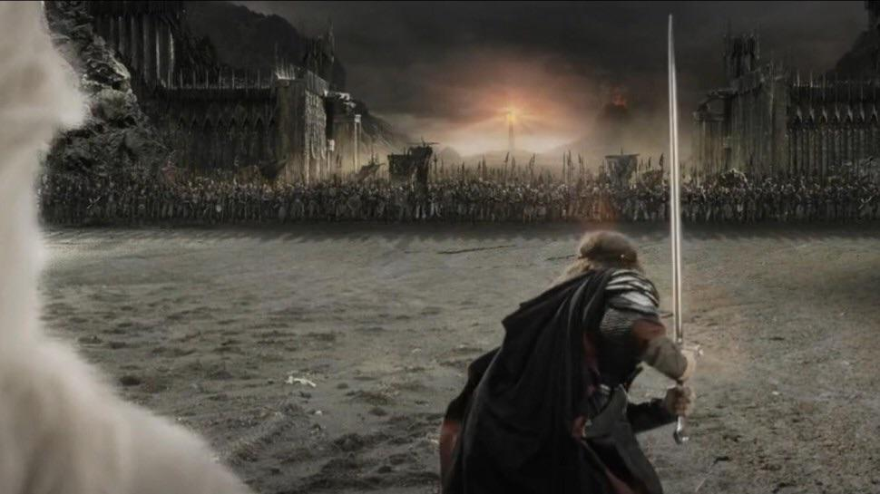
‘Lord’ Image style transfer
Get ready to be amazed…
Authors:
Negin Amininodoushan
Simone
Ercolino
Leonardo
Placidi
‘FOR COMPUTER VISION’

Slide 2
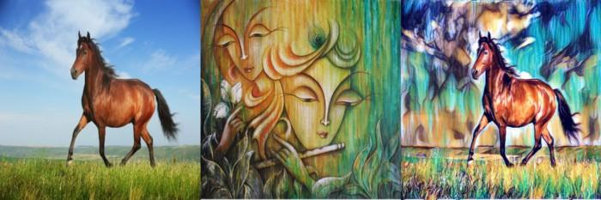
What is Image style transfer?
The task is to take two images, extract content from one image, style(texture) from the other and merge them together into one final image that looks realistic.

Slide 3
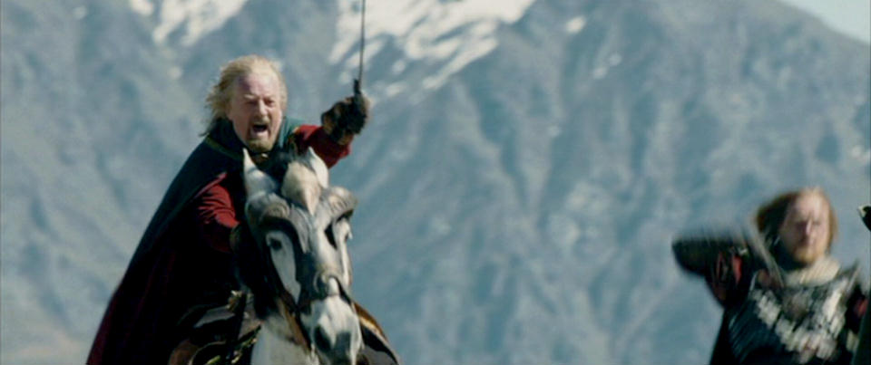
Walk with us through our journey!

Slide 4
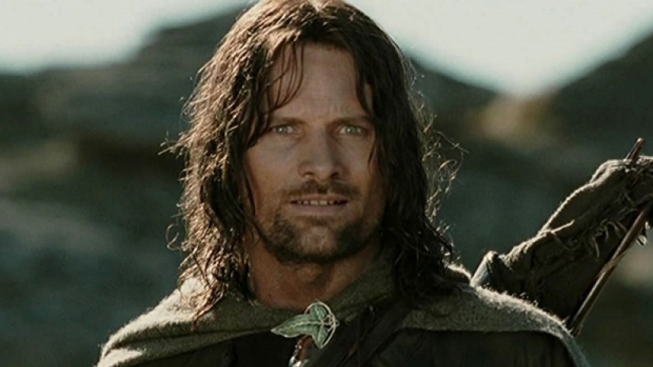

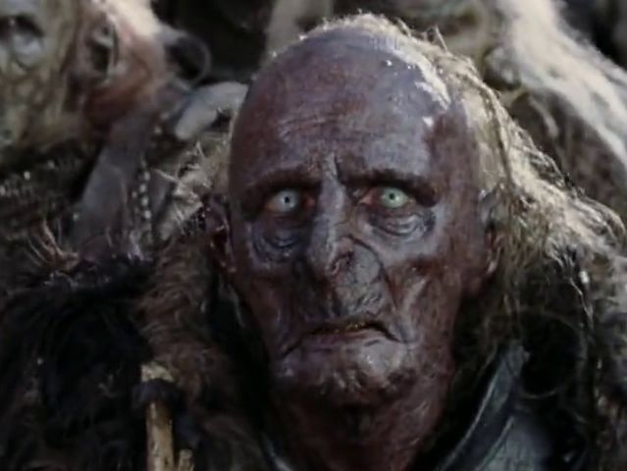
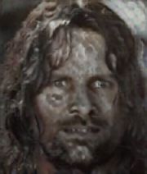
First experience: TensorFlow Hub model
Content image
Style transfer only on faces
Style image

Slide 5
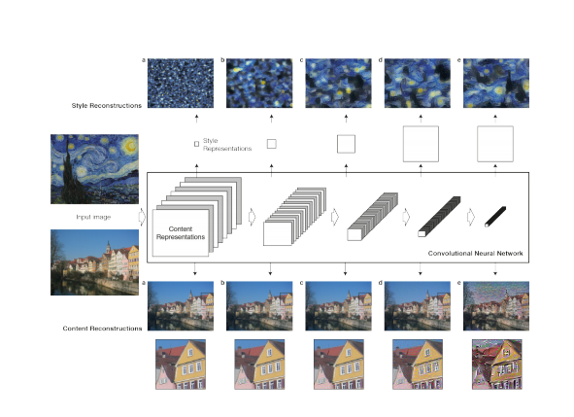
Feature maps of VGG-19 Network
The representations of content and style in the Convolutional Neural
Network are separable Manipulate both representations independently to produce new, perceptually meaningful images.
bib[4]

Slide 6
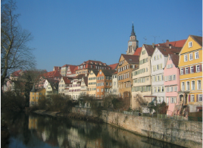
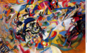
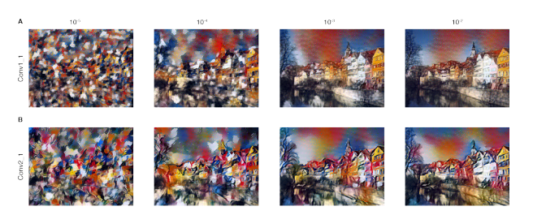
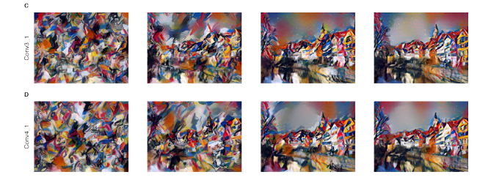
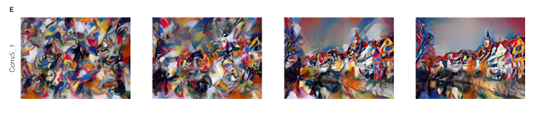
Feature maps of VGG-19 Network
+
Color information : In lower layers
(conv1-1, conv2-2)
texture/style information : In middle layers
from conv3-1 to conv4-4
content information : In last layers
from conv5-1 to conv5-4

Slide 7
Style transfer distribution by Gram matrix
Content loss MSE loss between the reconstructed image features
and content image features (without flattening)

Slide 8
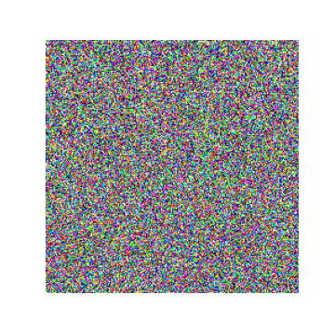
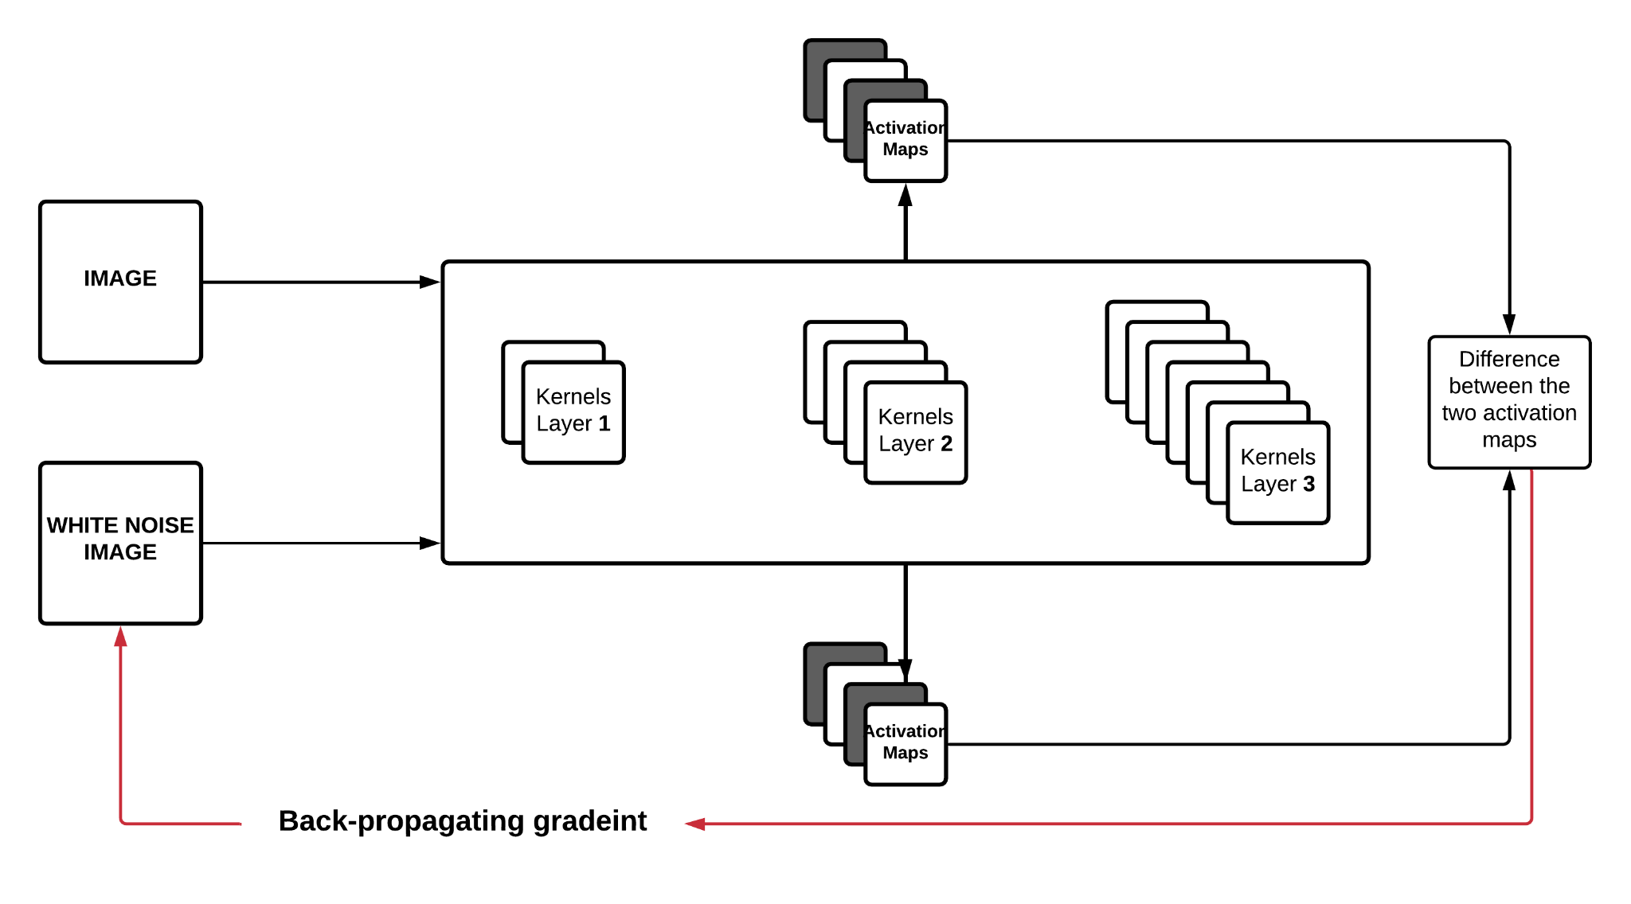
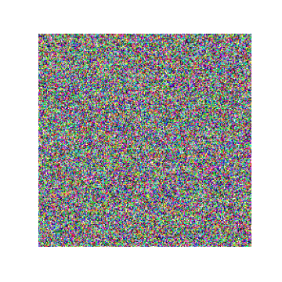
Transferring content to a white noise image

Slide 9

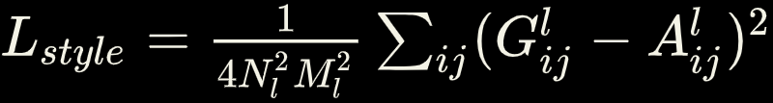
Style transfer distribution by Gram matrix
Style loss MSE loss between the gram matrix of reconstructed image and the style image.
Gram Matrix :

Slide 10
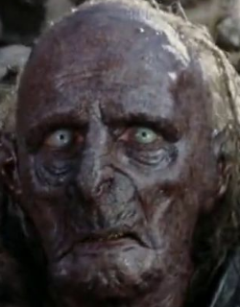

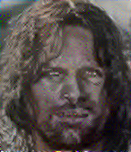
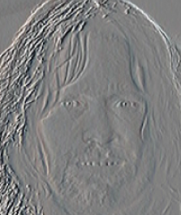
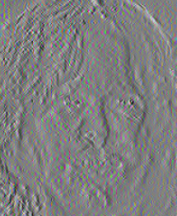
Style transfer distribution by Gram matrix
+
=

Slide 11
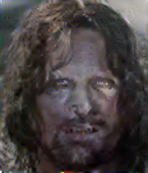
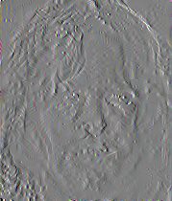
How to remove high frequency noises?
Add another loss term (Total variational loss)

Slide 12
Downsides and solutions
Undesired style and texture changes in the background
Not very specific changes to the different parts of the face (nose, eyes, lips, …)
How to put back the cropped face back to the original image? (inconsistency)
Next step: considering face segmentation and style transfering matching pairs.

Slide 13
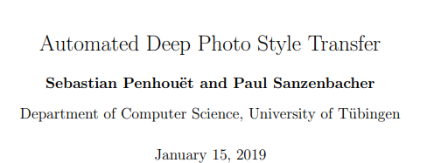
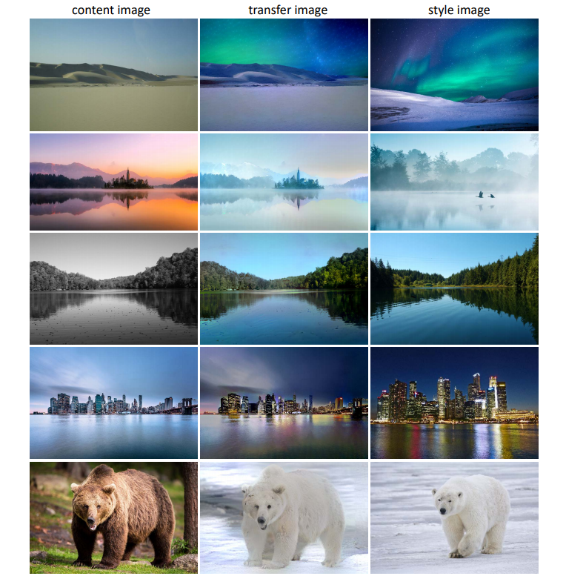
bib [2]

Slide 14
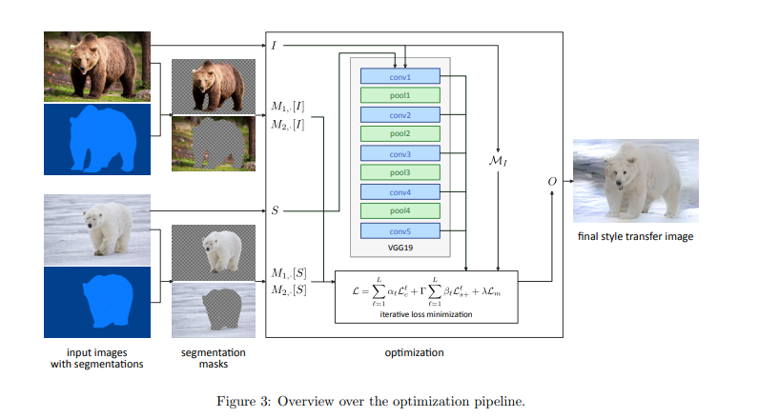
Deep style transfer
The Deep Photo Style Transfer algorithm consists of creating a segmentation mask, grouping segmentation classes, defining and precomputing loss functions and gradually optimizing the transfer image.

Slide 15
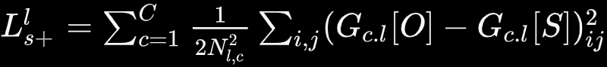
A NEW LOSS to include semantic regions!
Style loss → computed encoding Gram matrices → does not take semantic regions into account
→ use semantic segmentation!
→ a NEW LOSS!

Slide 16

The Matting Laplacian
The matting laplacian is a closed-form image matting method to extract an object from an image, this matting laplacian represents a gray scale matte as a locally affine combination of the red, green and blue (RGB) input channels.
The affine loss is defined as:

Slide 17

The final Loss
Final loss formula = Neural style transfer + Augmented style loss + photorealism regularization
= weighting parameter for affine loss

Slide 18
We didn’t use the NIMA loss (used in bib[2])
NIMA is a model trained to rate the aesthetics of images based on human reference ratings.
And we decided to not use it since:
it does not seem to provide a reasonable aesthetic rating. It is possible that images that look worse subjectively than other images achieve a higher NIMA score.
making images look subjectively good or aesthetically does not necessarily correlate with images looking photorealistic.

Slide 19
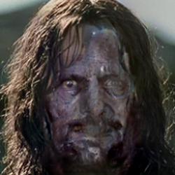
Attributions of the Deep style transfer model
with NIMA loss as you can see results are disappointing.

Slide 20
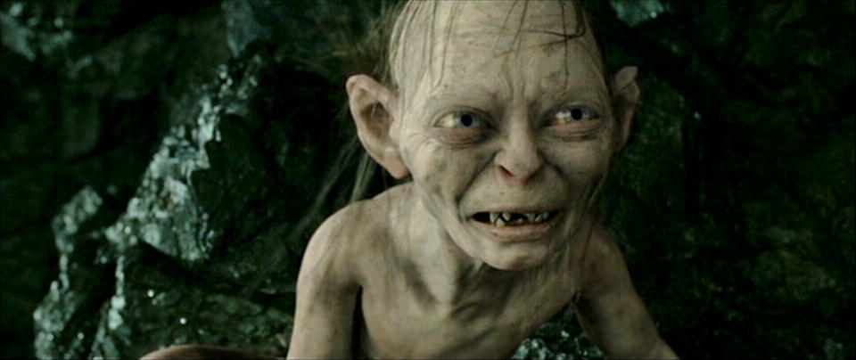
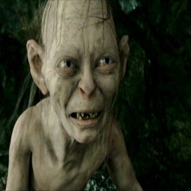
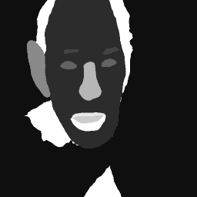
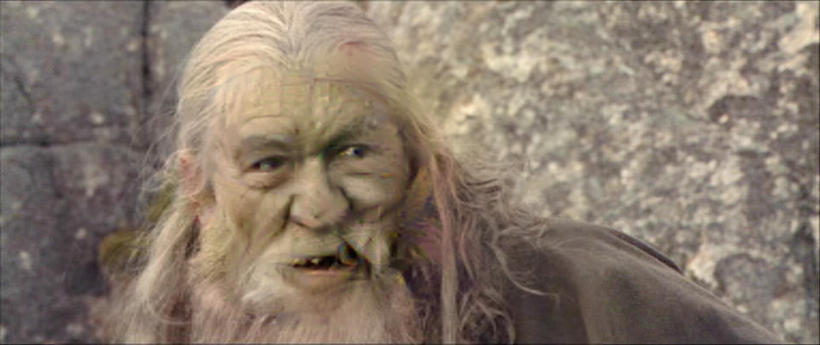
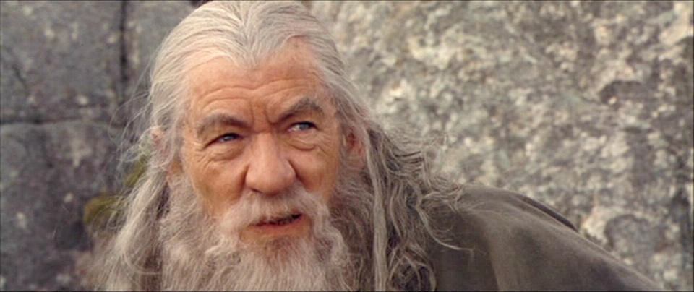
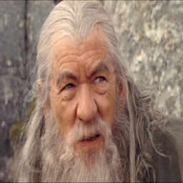
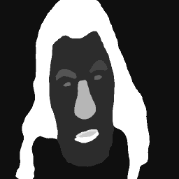
Our Model Pipeline
Style Image
Face Crops
(256x256)
Face Parsing
Replacing Crop (resized to original shape)
Content Image
MTCNN
BiSeNet
Style Transfer

Slide 21
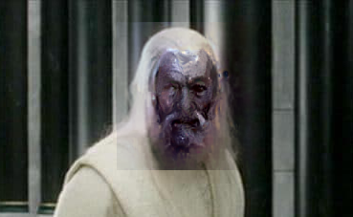
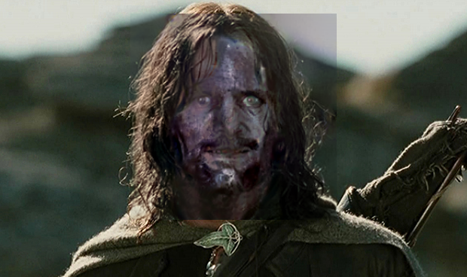
Replacing the transferred crop in the original image
We noticed that doing the style transfer on crops and placing them back in the original images produced visible horizontal and/or vertical crop edges, especially when the style image has darker colors, due to resizing from 256x256 back to the original crop shape, and also due to some colour leaking to the background during the transfer (although the background mask was explicitly removed from the transfer).

Slide 22
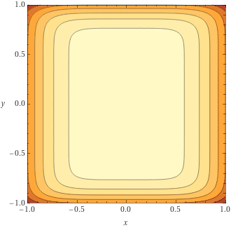
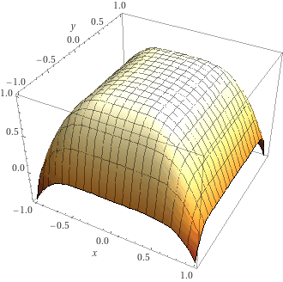
Merging the crop into the original image
The issue was solved by applying a weighted average of the original image and the transferred image, with weights applied to the transferred image following the function 1 - √(x^4 + y^8) clipped between 0 and 1. Thus, the weight of each pixel in the transferred crop is high towards the center of the crop and decreases towards the edges, and using their complements to unity as weights for the original image we managed to keep most of the transferred information in the central area, but gradually returning to the original colors towards the edges of each crop.

Slide 23
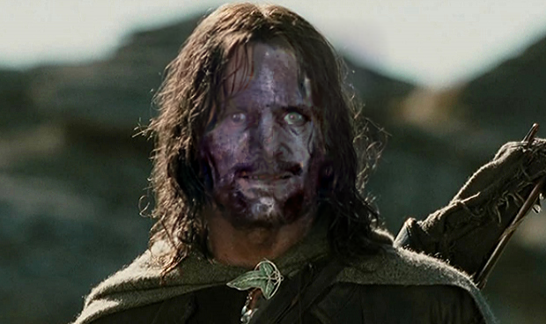
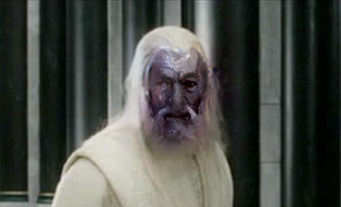
Comparison
Before
After

Slide 24
Performance
In bib[2] a minimum of 1000 iterations is needed and good results are achieved with about 2000 iterations on average.
In our work we concluded that an average of 1000 iterations was enough for good results, since we played around with learning rate and other parameters.
For most of the parameters ( semantic threshold, content initialization, content weight, etc..) we did keep the same of the paper bib[2], but as you can see depending on the images you are working with, there is alwasy a brief parameter tuning.

Slide 25
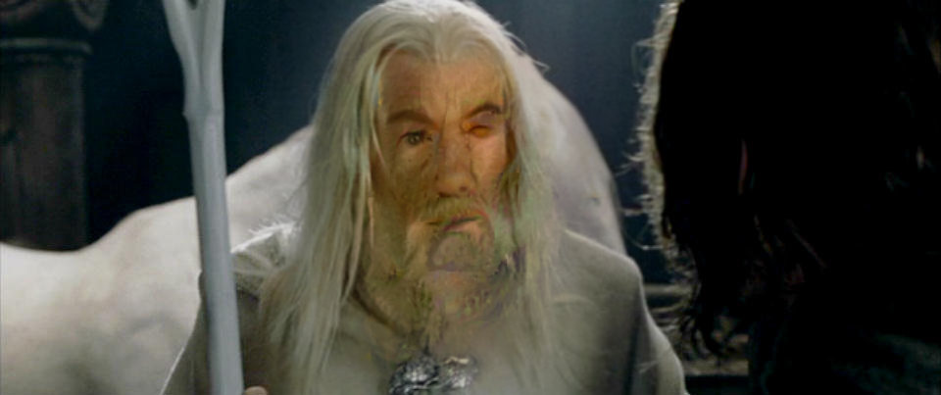
Limitations
sensitive to the segmentation and detection
problems with mixed or multiple classes in one position
Problems with well defined objects
⇒ break of photorealism

Slide 26
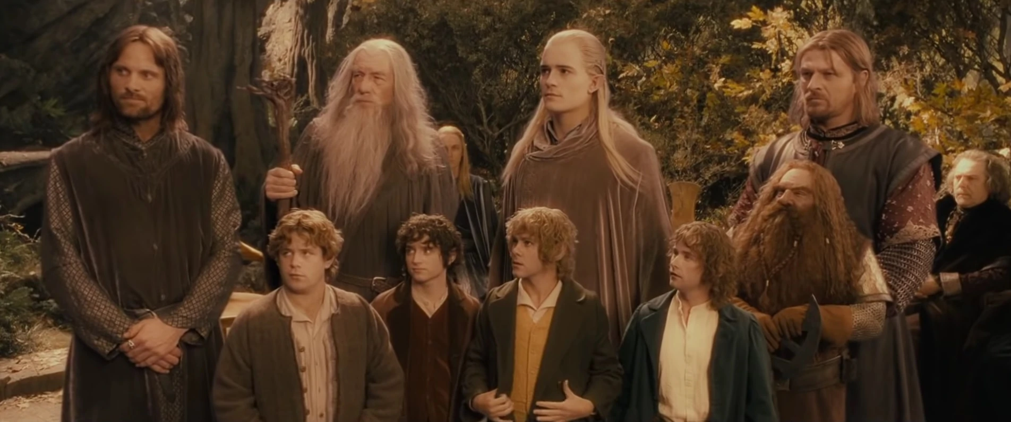
Future work
Multi-face detection and style transfer
Replacing Matting laplacian with a less expensive method
Develop end to end model for face detection and parsing together.

Slide 27
Bibliography
Our Senpai Luigi Cinque + Marco Raoul Marini and https://opencv.org/
‘Automated Deep Photo Style Transfer’ by Sebastian Penhouët, Paul Sanzenbacher -University of Tubingen - https://github.com/Spenhouet/automated-deep-photo-style-transfer
‘BiSeNet: Bilateral Segmentation Network for Real-time Semantic SegmentationChangqian’ by Yu et al. - Peking University et al.-
‘A Neural Algorithm of Artistic Style’ by Leon A. Gatys, Alexander S. Ecker, Matthias Bethge1 - University of Tubingen et al.
‘NIMA: Neural Image Assessment’ by Hossein Talebi, Peyman Milanfar - Google Inc.
‘On the Layer Choice of the Image Style Transfer Using Convolutional Neural Networks’ by P. Lee and C. Tseng - 2019 IEEE

Slide 28
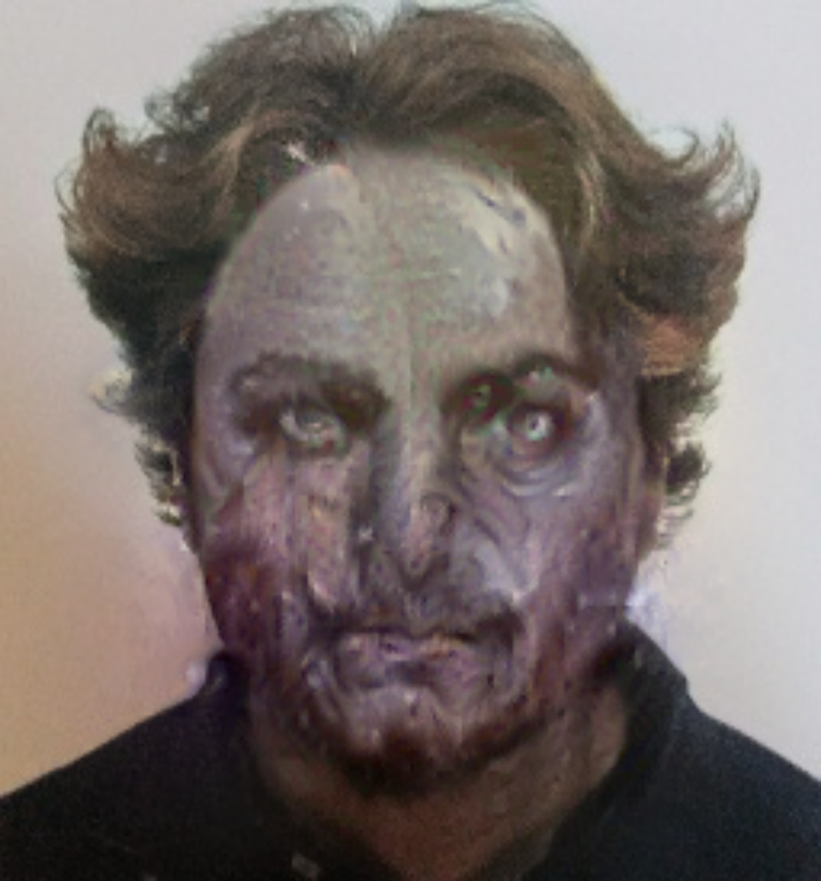
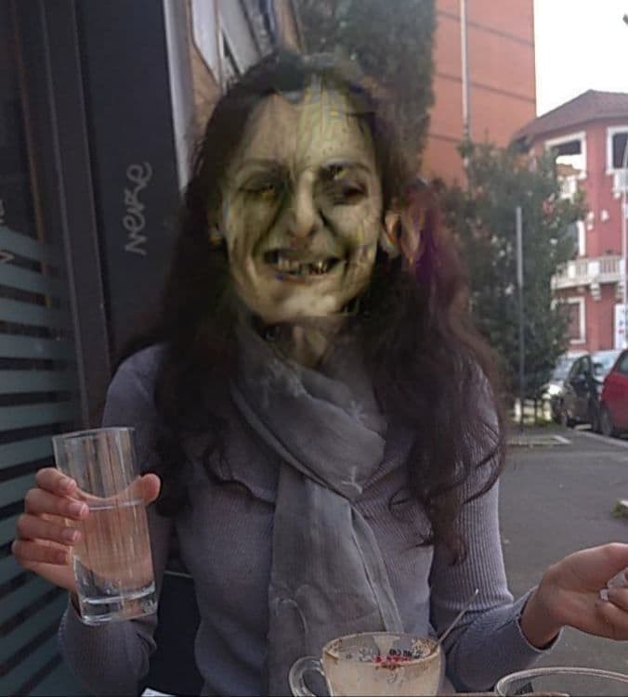
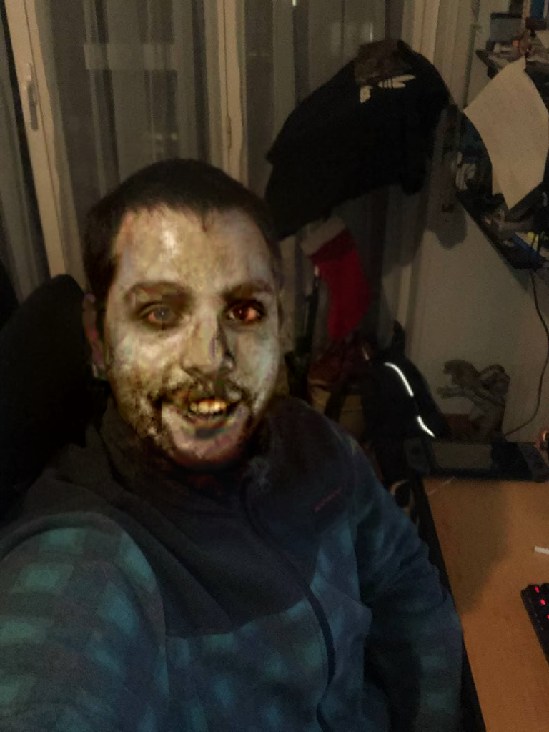
Our Team
Simone Orcolino
Negollum Amini
Leonorco Placidi
Our Github: https://github.com/Simonerc95/LOTR-Face-style-transfer

Slide 29
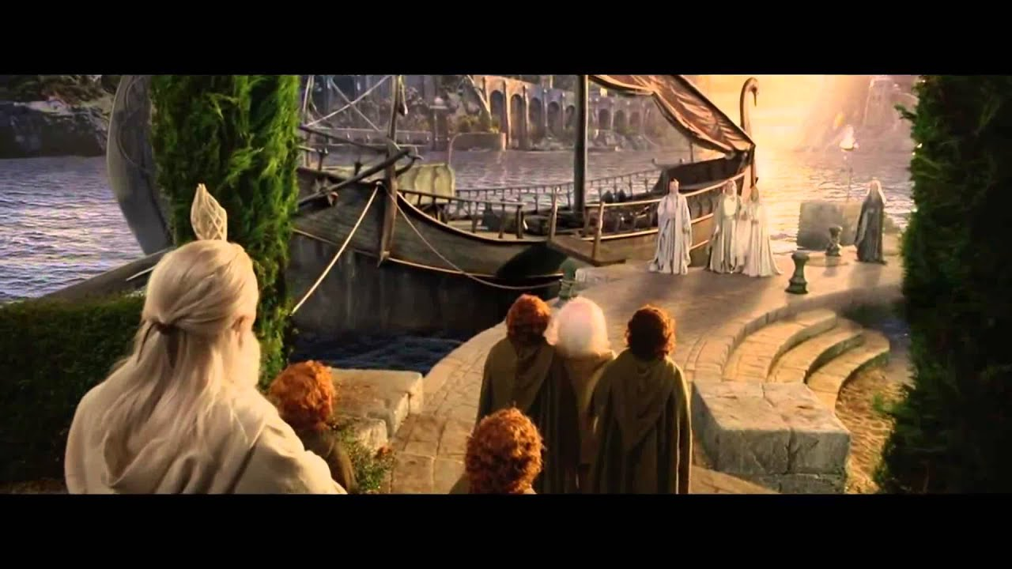

Thanks for the attention and let’s go to the DEMO!

Slide 30
APPENDIX

Slide 31
NOTE: The paper uses instead Automatic Image Segmentation
The Deep Photo Style Transfer algorithm requires a small number of segmentation classes that cover large regions in the image to reduce memory usage and computation overhead ⇒ Each class l is represented by a set of words describing the class
The semantic similarity between two class sets simmax is computed as the maximum semantic similarity sim of all class pairs
The semantic similarity score is computed using a Knowledge Graph (KG) from a Python library called Sematch.

